Slide 2

Convolutional Neural Network Inference (MPI, CUDA)
Group 1
Vũ Hữu An
Trần Hữu Đạo
Lại Trí Dũng
Đàm Quang Đức
Tạ Tuấn Hải
Nguyễn Trọng Tâm
20225467
20220061
20225486
20225483
20225442
20225527
Professor: Ph.D. Vu Van Thieu

Slide 3
MỤC LỤC
I. ABOUT OUR PROBLEM
II. ALGORITHM IMPLEMENTATION
III. PARALLEL DESIGN
IV. RESULTS AND CONCLUSION

Slide 4
I. ABOUT OUR PROBLEM

Slide 5
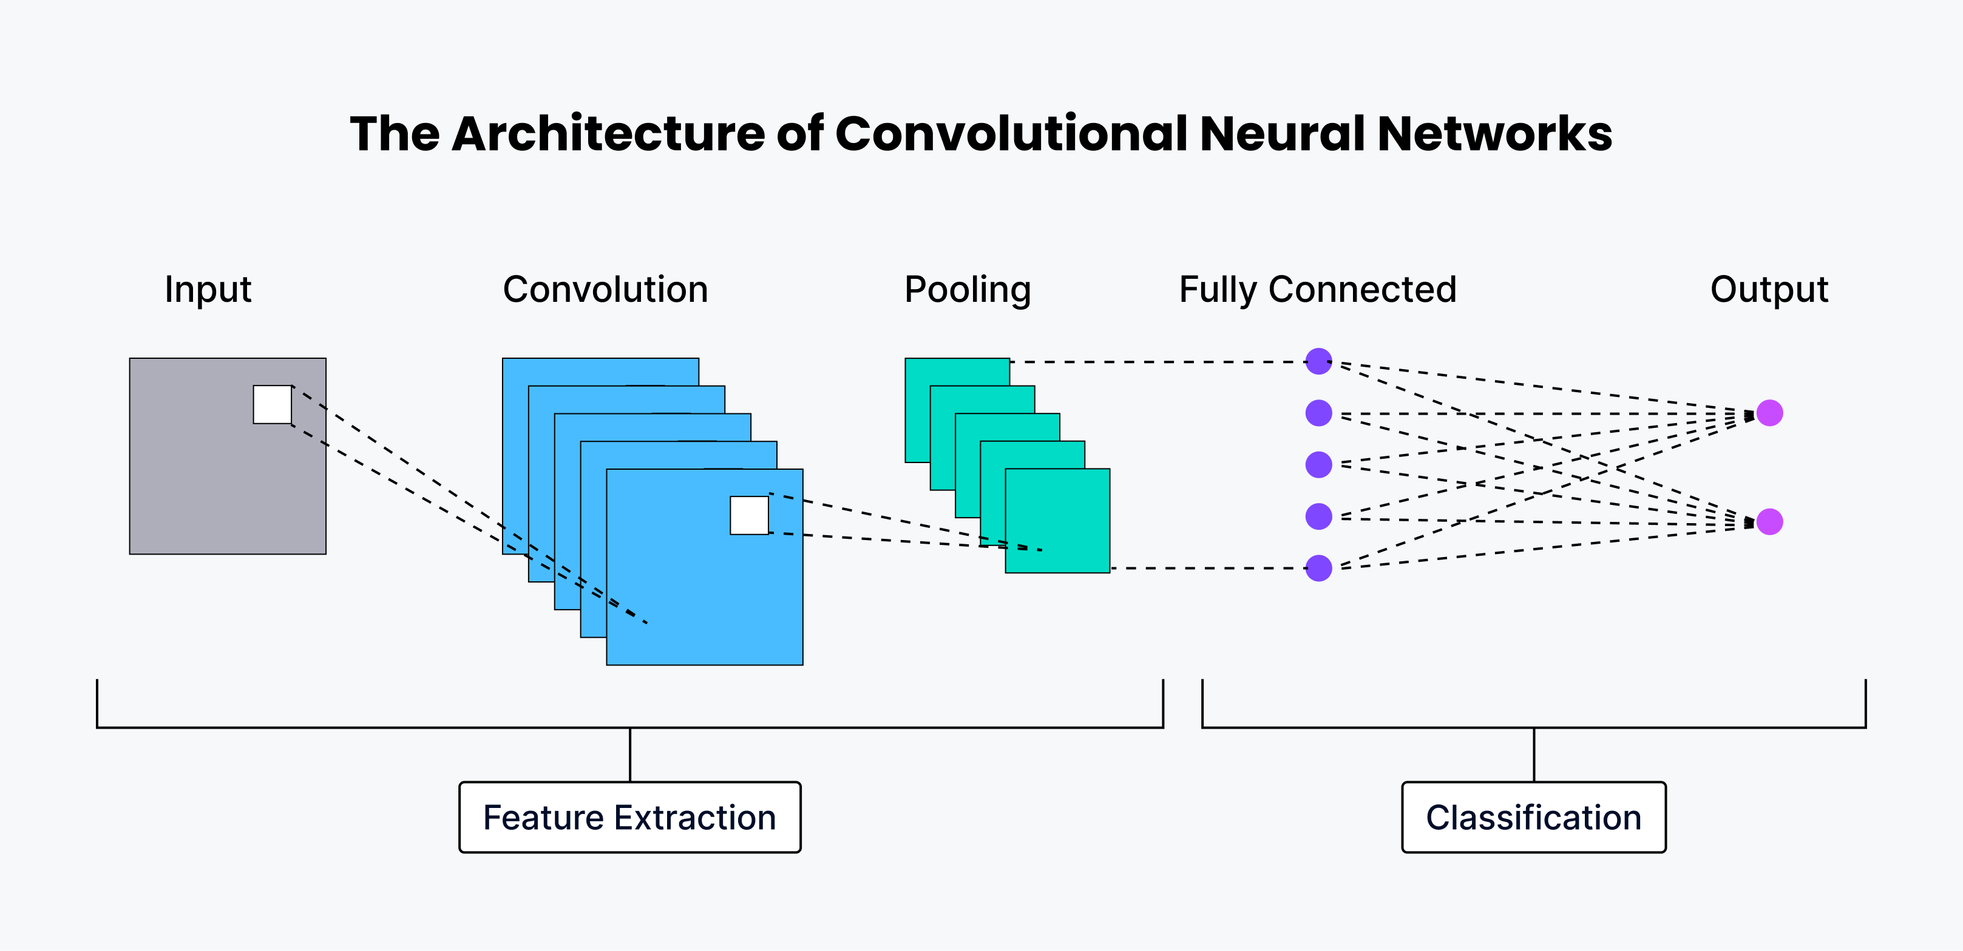
1. Resource Optimization Needs
• CNNs are widely applied in modern artificial intelligence.
• Networks’ size increases training and inference demands.
• Real-world systems demand resource optimization methods.

Slide 6
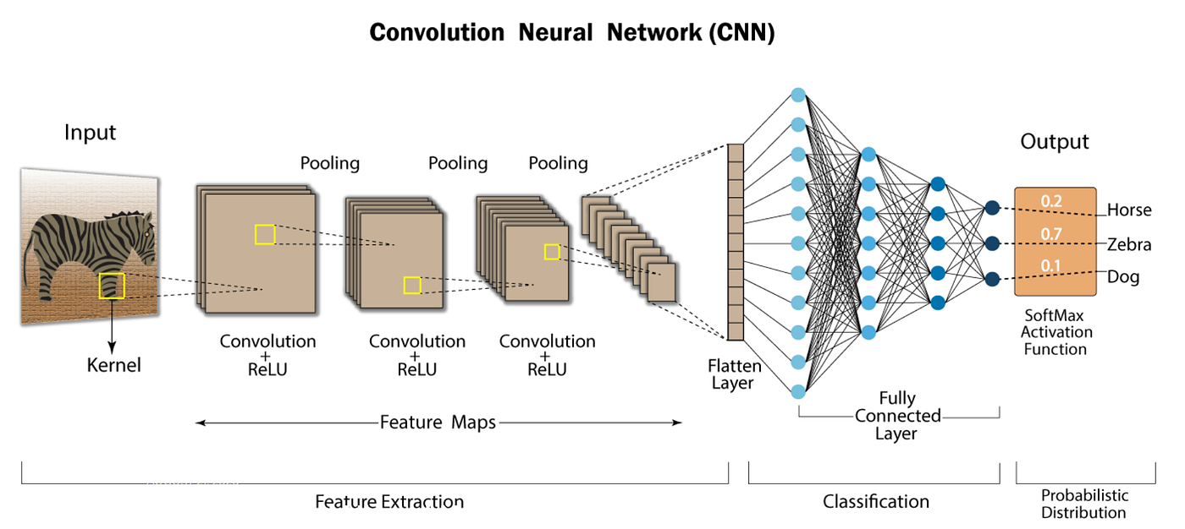
2. CNNs architecture
• Convolutional layers follow activation functions
• Pooling layers reduce spatial dimensions
• Flattened maps feed fully connected
• Fully connected layers generate predictions

Slide 7
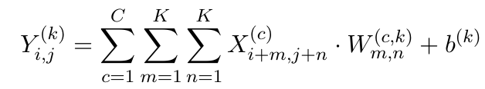
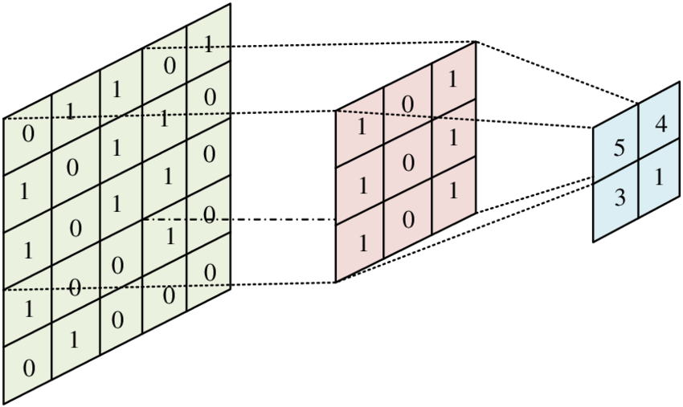
2. CNNs architecture
2.1. Convolutional Layer
• X(c): the input feature map for channel c.
• W(c,k): the filter weights.
• b(k): bias for output channel k.
• K: kernel size.
• C: number of input channels.
• F: number of filters (output channels).

Slide 8
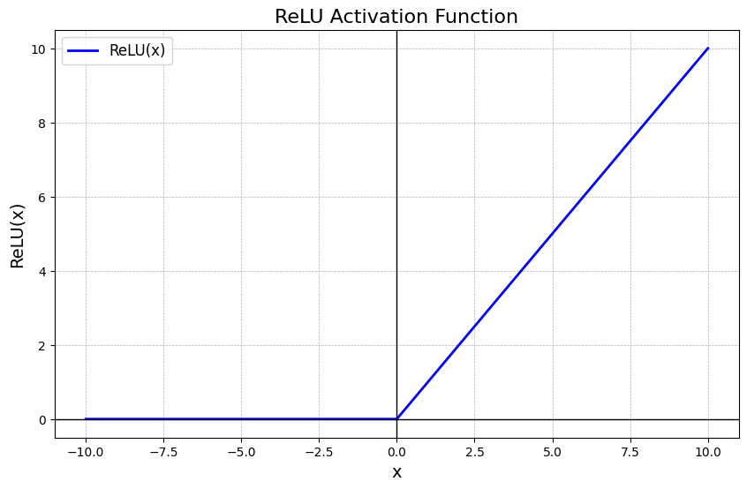
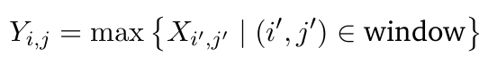

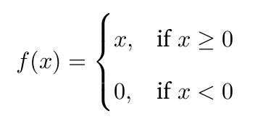
2. CNNs architecture
2.2. Activation Function & Max Pooling Layer

Slide 9
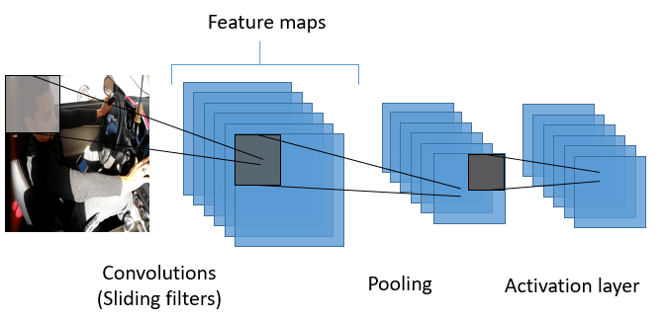
2. CNNs architecture
2.3. Layer Stacking
Combination of convolution, activation, and pooling

Slide 10
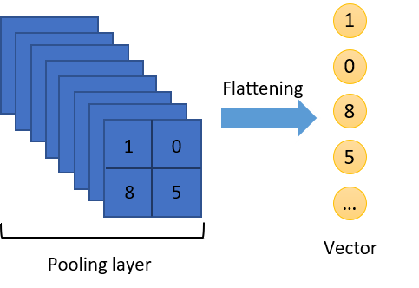
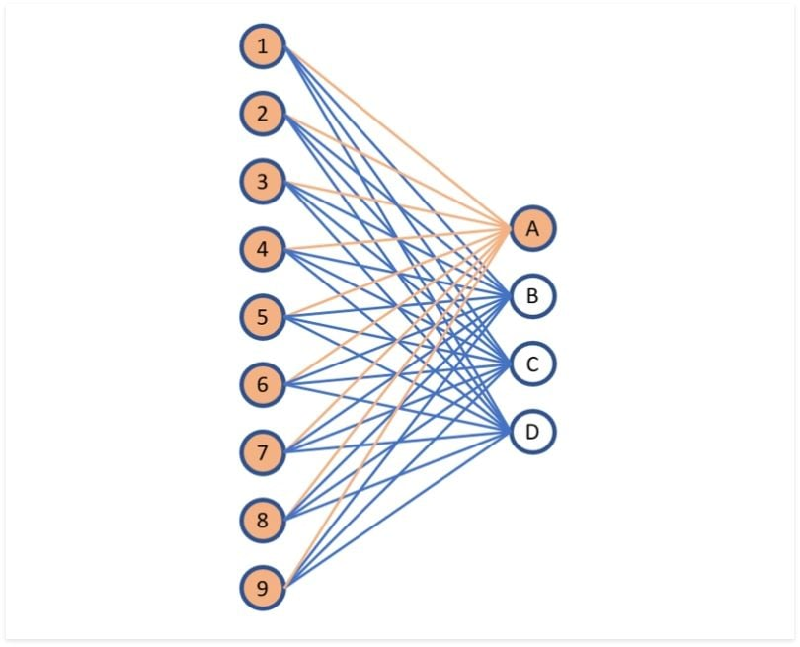
2. CNNs architecture
2.4. Flattening & Fully Connected Layers
• The resulting feature maps are flattened.
• One-dimensional vector feeds fully connected layers.
• Flattened vector feeds one-or-more dense layers.

Slide 11
II. ALGORITHM IMPLEMENTATION

Slide 12
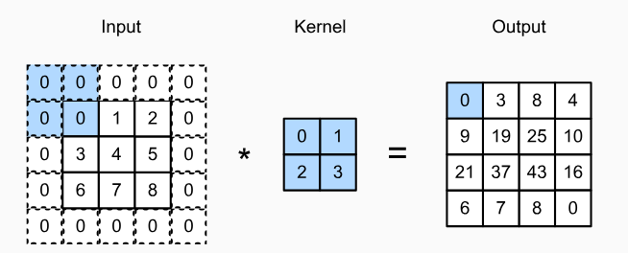
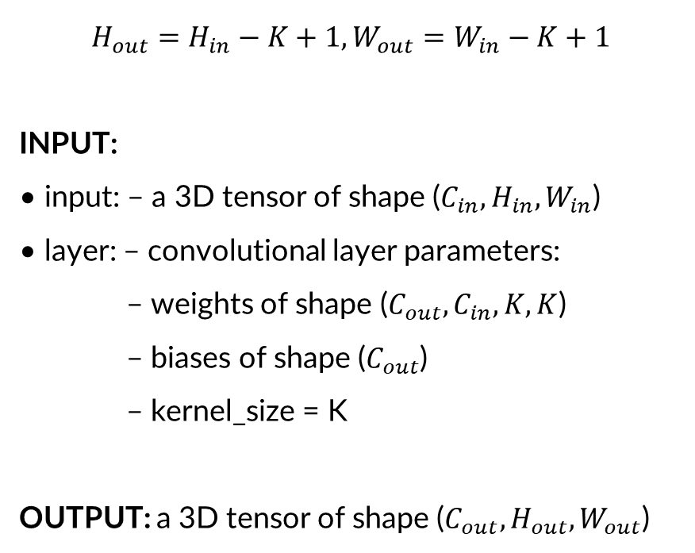
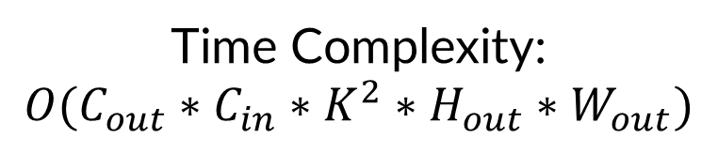
1. Stage 1 – conv_forward
$$H_{out}=H_{in}−K+1, W_{out}=W_{in}−K+1$$
INPUT:
• input: – a 3D tensor of shape ($C_{in}, H_{in}, W_{in}$)
• layer: – convolutional layer parameters:
– weights of shape ($C_{out}, C_{in},K,K$)
– biases of shape ($C_{out}$)
– kernel_size = K
OUTPUT: a 3D tensor of shape ($C_{out}, H_{out}, W_{out}$)
Time Complexity:
$$O(C_{out}∗C_{in}∗K^{2}∗H_{out}∗W_{out})$$

Slide 13
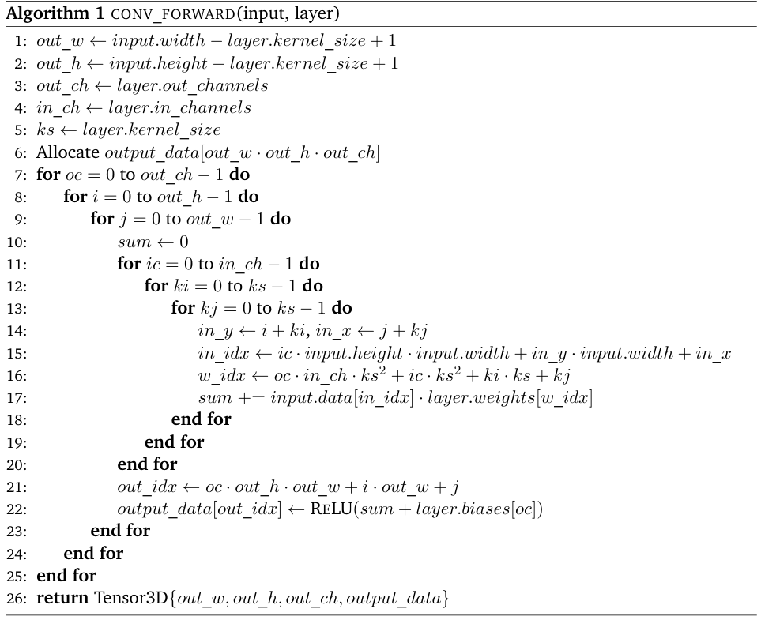
1. Stage 1 – conv_forward

Slide 14
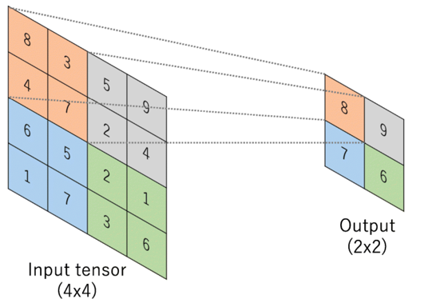
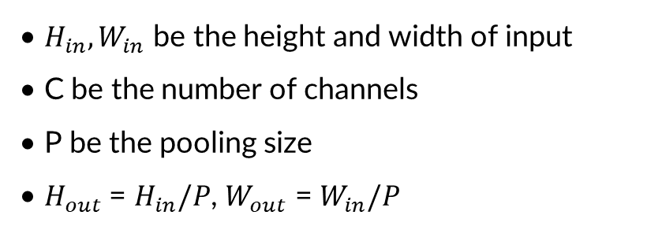
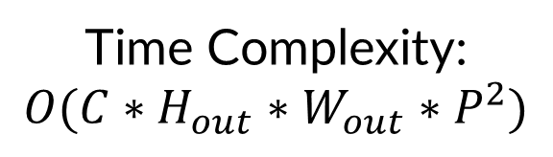
2. Stage 2 – max_pool_forward
• Apply 2D max pooling over pool_size×pool_size regions
• Reducing resolution while preserving features.
• $H_{in},W_{in}$ be the height and width of input
• C be the number of channels
• P be the pooling size
• $H_{out}$ = $H_{in}/P$, $W_{out}$ = $W_{in}/P$
Time Complexity:
$$O(C∗H_{out}∗W_{out}∗P^{2})$$

Slide 15
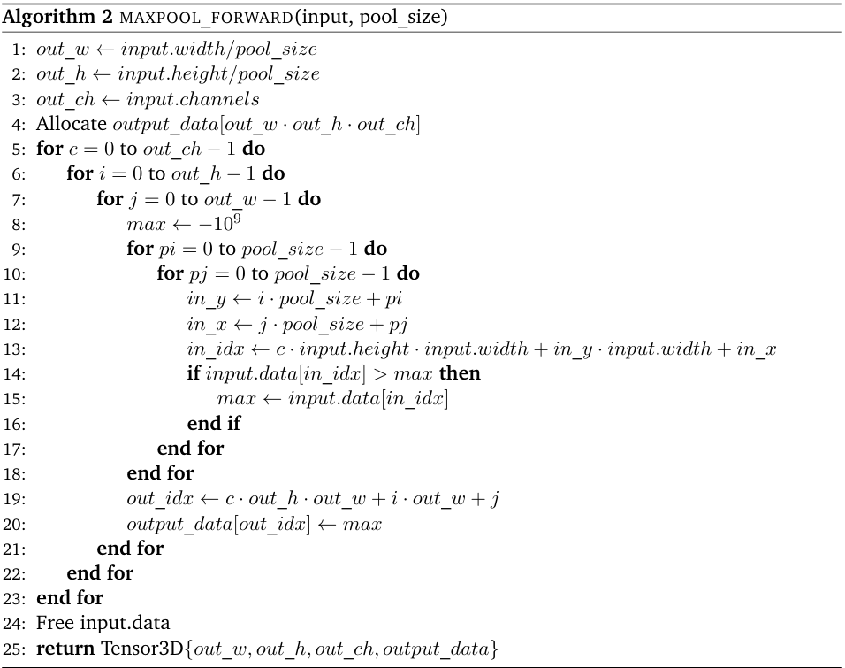
2. Stage 2 – max_pool_forward

Slide 16
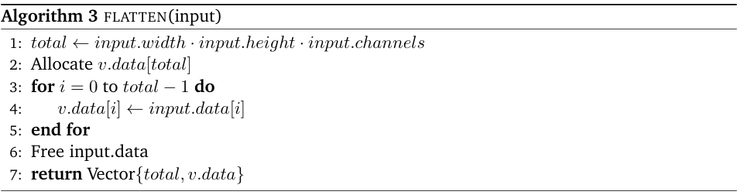
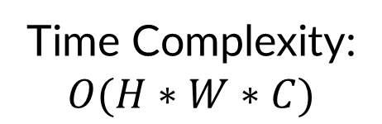
3. Stage 3 – flatten + fully connected
flatten reshapes a $(H∗W∗C)$ tensor into an $(H,W,C)$ – length vector in row-major order.
Time Complexity:
$$O(H∗W∗C)$$

Slide 17
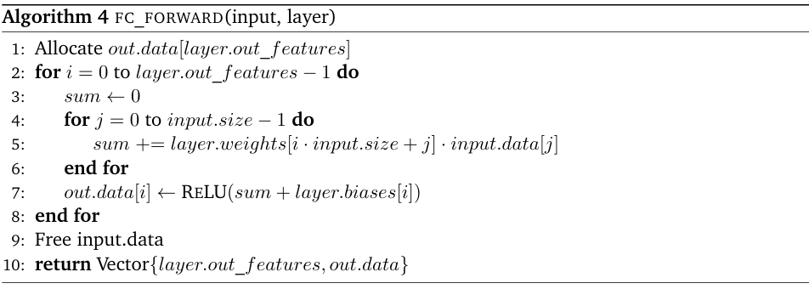
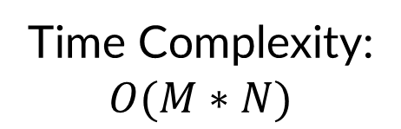
3. Stage 3 – flatten + fully connected
fc_forward multiplies input by weights, adds bias, then applies ReLU.
• N be the input size (flattened vector length)
• M be the number of output features
Time Complexity:
$$O(M∗N)$$

Slide 18
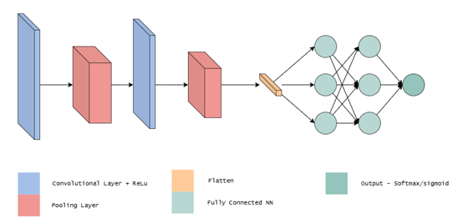
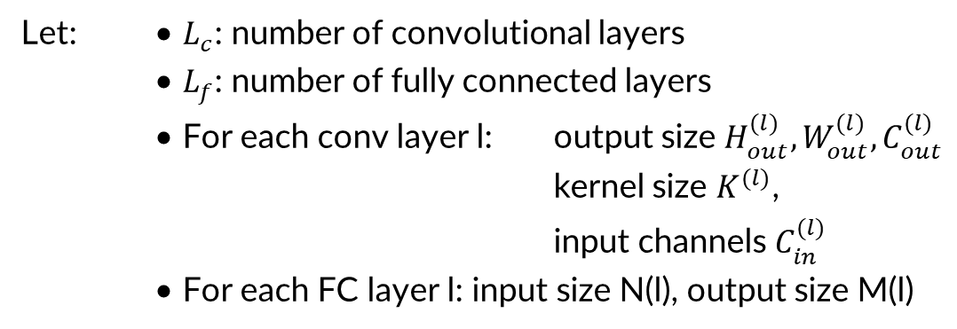
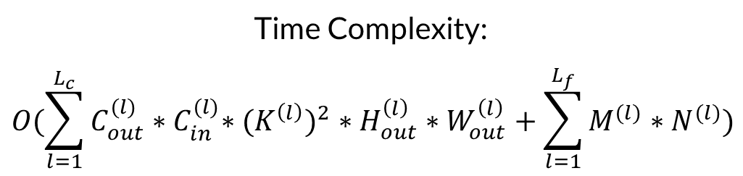
4. Stage 4 – Combining into cnn_forward
Let: • $L_{c}$: number of convolutional layers
• $L_{f}$: number of fully connected layers
• For each conv layer l: output size $H_{out}^{(l)},W_{out}^{(l)},C_{out}^{(l)}$
kernel size $K^{(l)}$,
input channels $C_{in}^{(l)}$
• For each FC layer l: input size N(l), output size M(l)
Time Complexity:
$$O(\sum_{l=1}^{L_{c}}{C_{out}^{(l)}{∗C}_{in}^{(l)}∗{{(K}^{\left(l\right)})}^{2}∗H_{out}^{\left(l\right)}∗W_{out}^{\left(l\right)}+\sum_{l=1}^{L_{f}}{M^{(l)}∗N^{(l)}}})$$

Slide 19
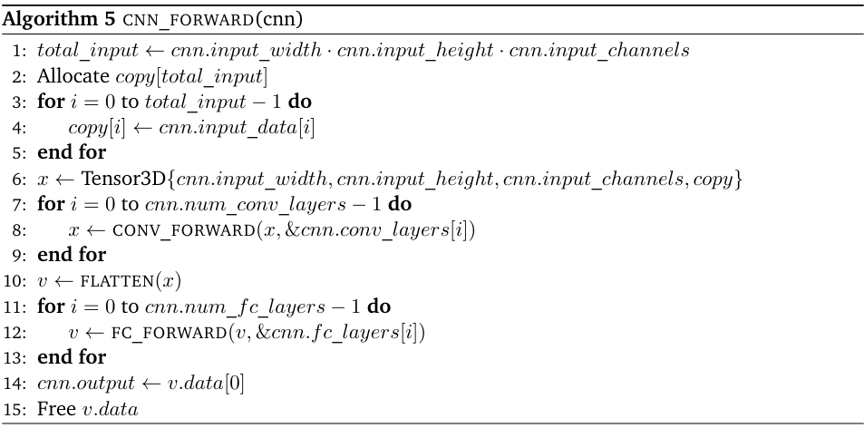
4. Stage 4 – Combining into cnn_forward

Slide 20
III. PARALLEL DESIGN

Slide 21
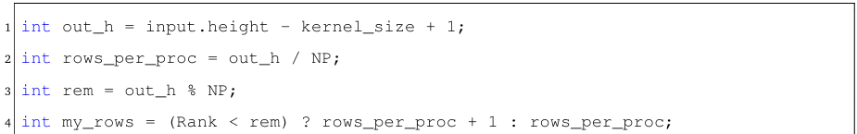
1. MPI-Based Implementation
1.1. Convolutional Layer
The convolution is parallelized by assigning output rows to different processes, each computing all channels for its subset. This requires each process to:
• Access a subset of rows from the input tensor.

Slide 22
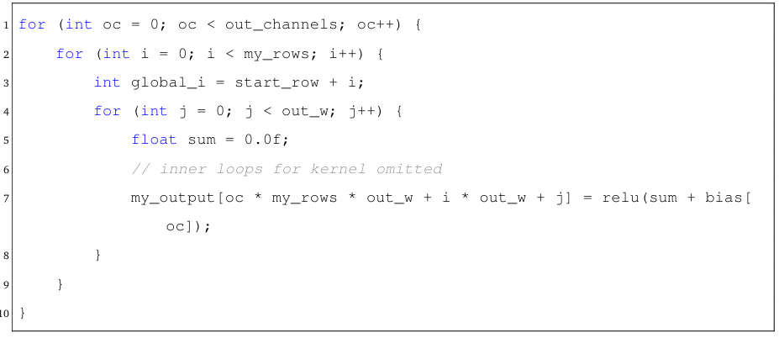
1. MPI-Based Implementation
1.1. Convolutional Layer
• Perform the full convolution kernel computation over those rows.

Slide 23
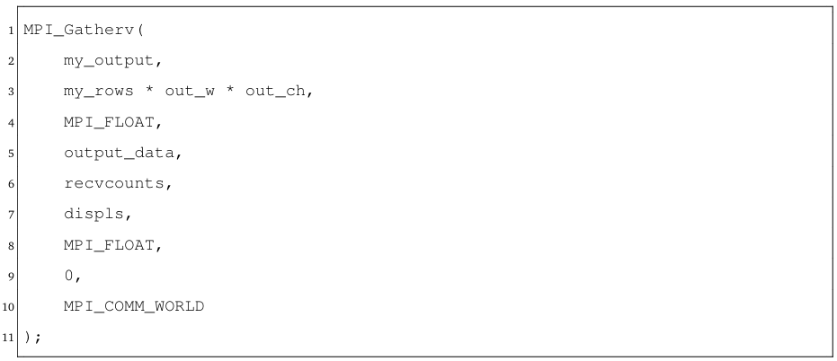
1. MPI-Based Implementation
1.1. Convolutional Layer
• Store intermediate results locally.

Slide 24
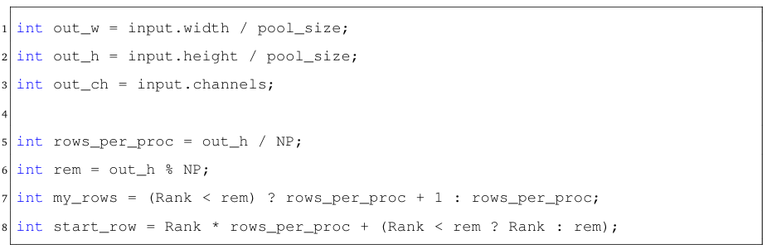
1. MPI-Based Implementation
1.2. Max Pooling Layer
The max pooling is parallelized by splitting the output rows among MPI processes, with each process computing its assigned rows across all channels.
• Compute the output tensor dimensions and determine the row range for each process:

Slide 25
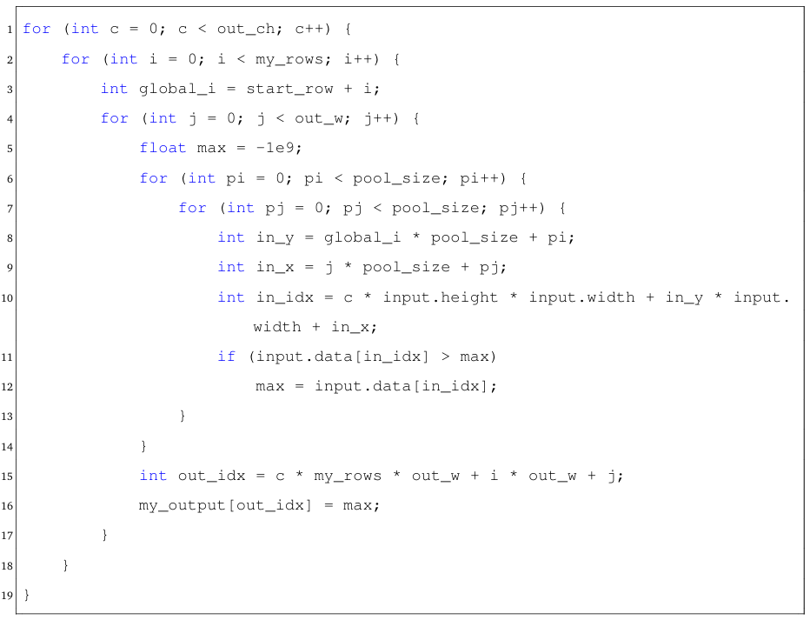
1. MPI-Based Implementation
1.2. Max Pooling Layer
• For each output pixel, the local process computes the maximum value over a pool_size × pool_size window in the corresponding input region.
• After local computation, each process sends its computed rows to rank 0 using MPI_Gatherv.

Slide 26
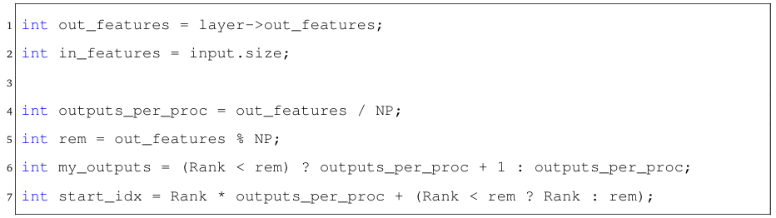
1. MPI-Based Implementation
1.3. Fully Connected Layer
The fully connected layer is parallelized by assigning different output neurons to each MPI process, with each process independently computing its portion of the output vector.
• Divide the total number of output neurons across processes:

Slide 27
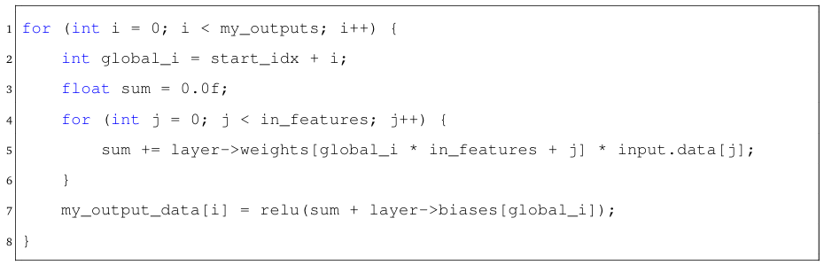
1. MPI-Based Implementation
1.3. Fully Connected Layer
• Each process computes its assigned output neurons:
• After local computation, each process sends its computed rows to rank 0 using MPI_Gatherv.

Slide 28
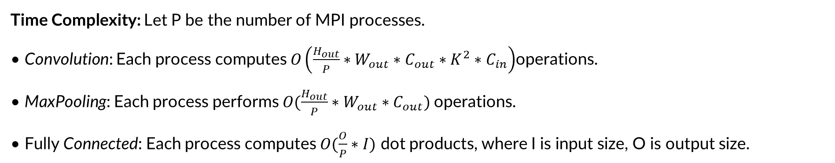
1. MPI-Based Implementation
1.4. Overall Design and Synchronization
Time Complexity: Let P be the number of MPI processes.
• Convolution: Each process computes $O\left(\frac{H_{out}}{P}∗W_{out}∗C_{out}∗K^{2}∗C_{in}\right)$operations.
• MaxPooling: Each process performs $O(\frac{H_{out}}{P}∗W_{out}∗C_{out})$operations.
• Fully Connected: Each process computes $O(\frac{O}{P}∗I)$ dot products, where I is input size, O is output size.
Communication cost per layer includes gather (MPI_Gatherv) and broadcast (MPI_Bcast) with time complexity $Olog\left(P\right)$latency and $O\left(n\right)$bandwidth per transfer.

Slide 29
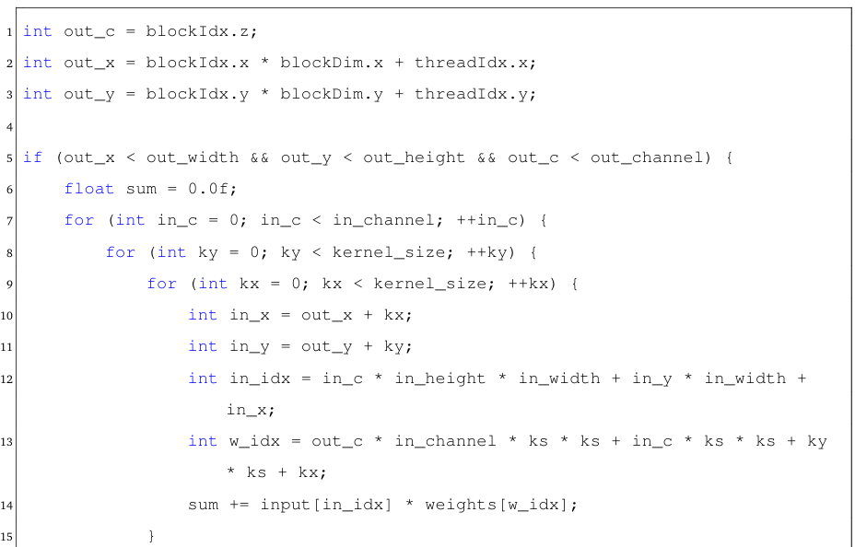
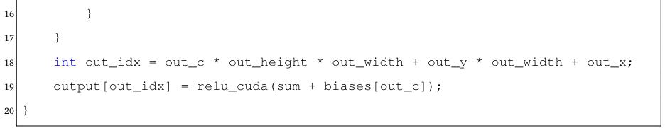
2. CUDA-Based Implementation
2.1. Convolutional Layer
The kernel is executed with a 3D grid of thread blocks:
• Each thread block covers a 2D spatial tile
• Each block in z-dimension handles one output channel

Slide 30
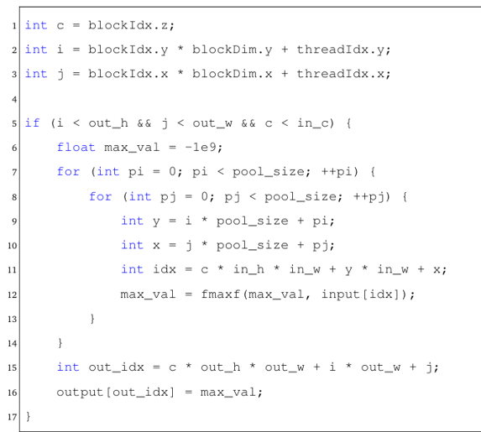
2. CUDA-Based Implementation
2.2. Max Pooling Layer
• Max pooling performed over spatial grid and channels
• Each CUDA thread reduces a pool_size×pool_size window

Slide 31
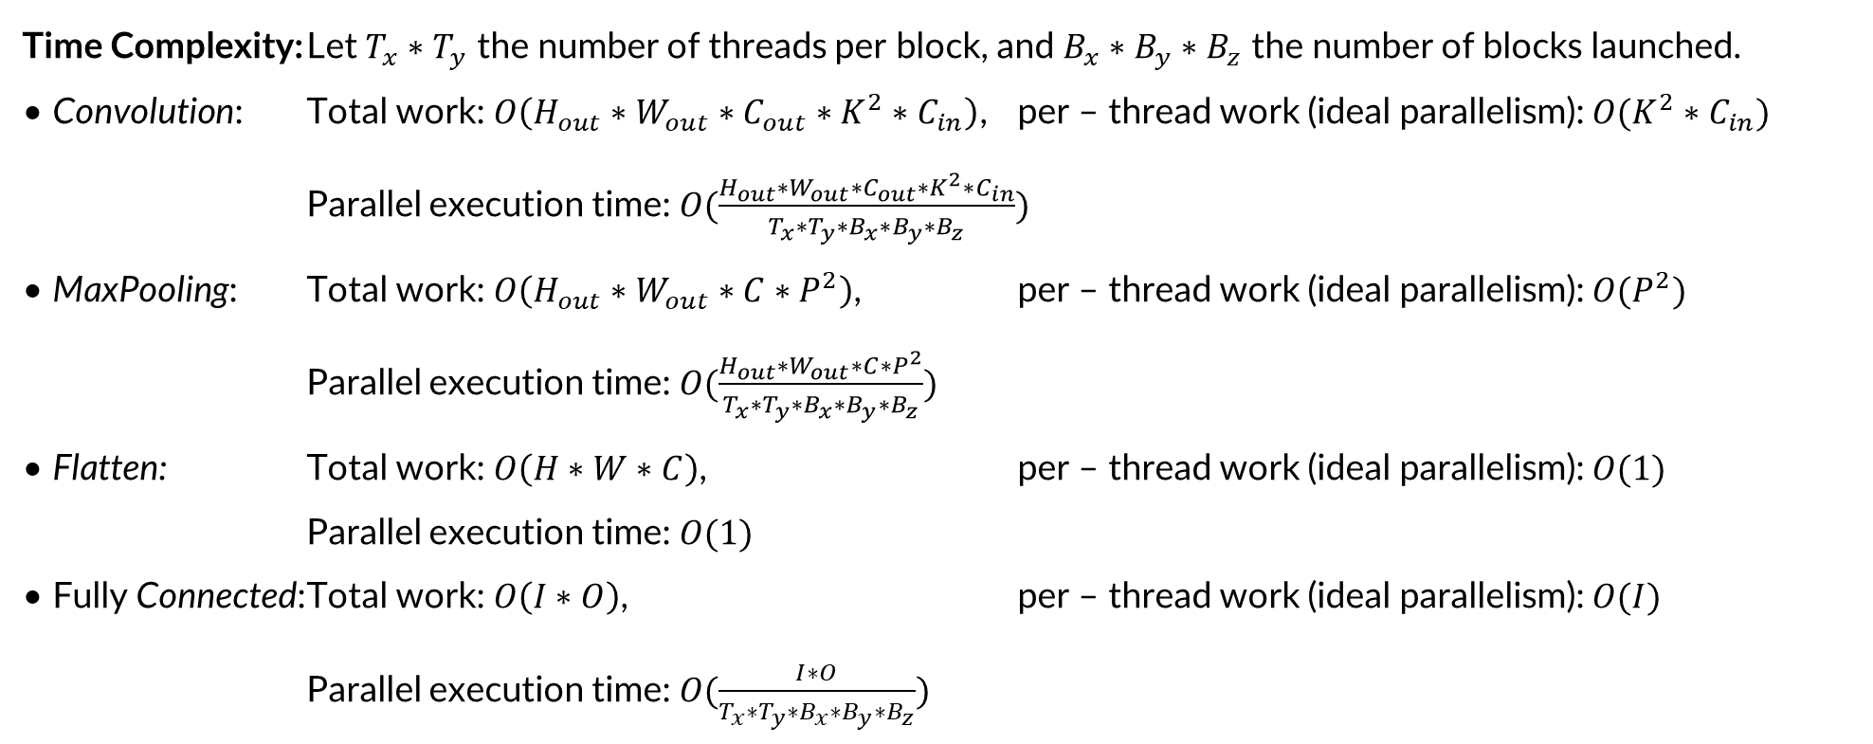
2. CUDA-Based Implementation
2.3. Fully Connected Layer
Input is copied to GPU, multiplied by the weight matrix, then sent back to the host.
Time Complexity: Let $T_{x}∗T_{y}$ the number of threads per block, and $B_{x}∗B_{y}∗B_{z}$ the number of blocks launched.
• Convolution: Total work: $O\left(H_{out}∗W_{out}∗C_{out}∗K^{2}∗C_{in}\right)$, per – thread work (ideal parallelism): $O(K^{2}∗C_{in})$
Parallel execution time: $O(\frac{H_{out}∗W_{out}∗C_{out}∗K^{2}∗C_{in}}{T_{x}∗T_{y}∗B_{x}∗B_{y}∗B_{z}})$
• MaxPooling: Total work: $O\left(H_{out}∗W_{out}∗C∗P^{2}\right)$, per – thread work (ideal parallelism): $O(P^{2})$
Parallel execution time: $O(\frac{H_{out}∗W_{out}∗C∗P^{2}}{T_{x}∗T_{y}∗B_{x}∗B_{y}∗B_{z}})$
• Flatten: Total work: $O\left(H∗W∗C\right)$, per – thread work (ideal parallelism): $O(1)$
Parallel execution time: $O(1)$
• Fully Connected: Total work: $O\left(I∗O\right)$, per – thread work (ideal parallelism): $O(I)$
Parallel execution time: $O(\frac{I∗O}{T_{x}∗T_{y}∗B_{x}∗B_{y}∗B_{z}})$

Slide 32
3. Hybrid MPI + CUDA Implementation
3.1. Workflow
The hybrid MPI + CUDA implementation leverages distributed computing and GPU acceleration to process images in parallel using a CNN. Each MPI process, linked to a GPU, handles a subset of images concurrently.
The hybrid implementation processes multiple images in parallel across GPUs as follows:
(1) The root MPI process initializes the CNN and loads images;
(2) Images are distributed using MPI_Scatterv;
(3) Each process uses CUDA to process its images;
(4) Results are gathered via MPI_Gatherv.

Slide 33
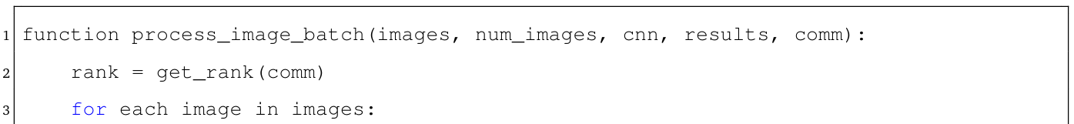
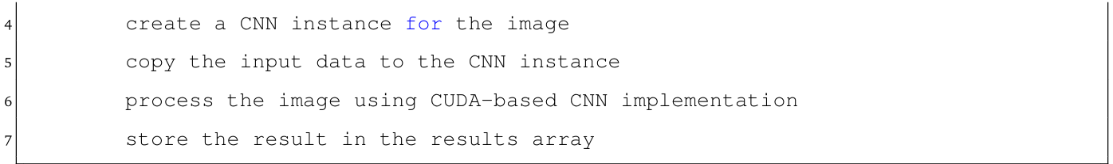
3. Hybrid MPI + CUDA Implementation
3.2. Implementation
The implementation includes two key functions: process_image_batch for processing image batches on a GPU, and cnn_forward_hybrid for managing MPI-based distribution and collection.
• The process_image_batch function uses CUDA-based CNN to process image batches within a single MPI process. The pseudo-code for this function is as follows:

Slide 34
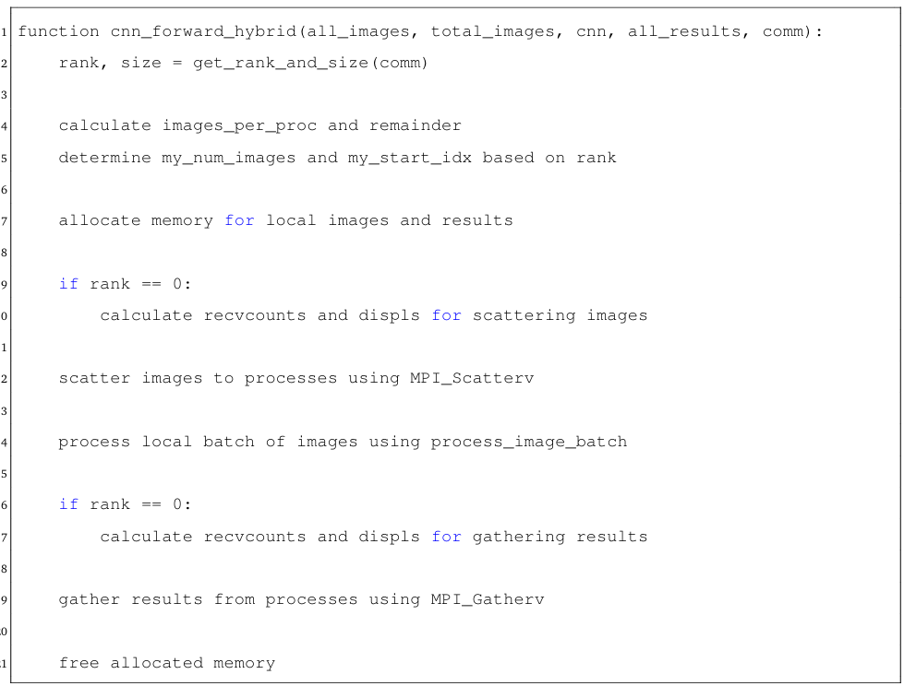
3. Hybrid MPI + CUDA Implementation
3.2. Implementation
• The cnn_forward_hybrid function performs distributed inference by scattering images and gathering results using MPI_Scatterv and MPI_Gatherv. The pseudo-code for this function is as follows:

Slide 35
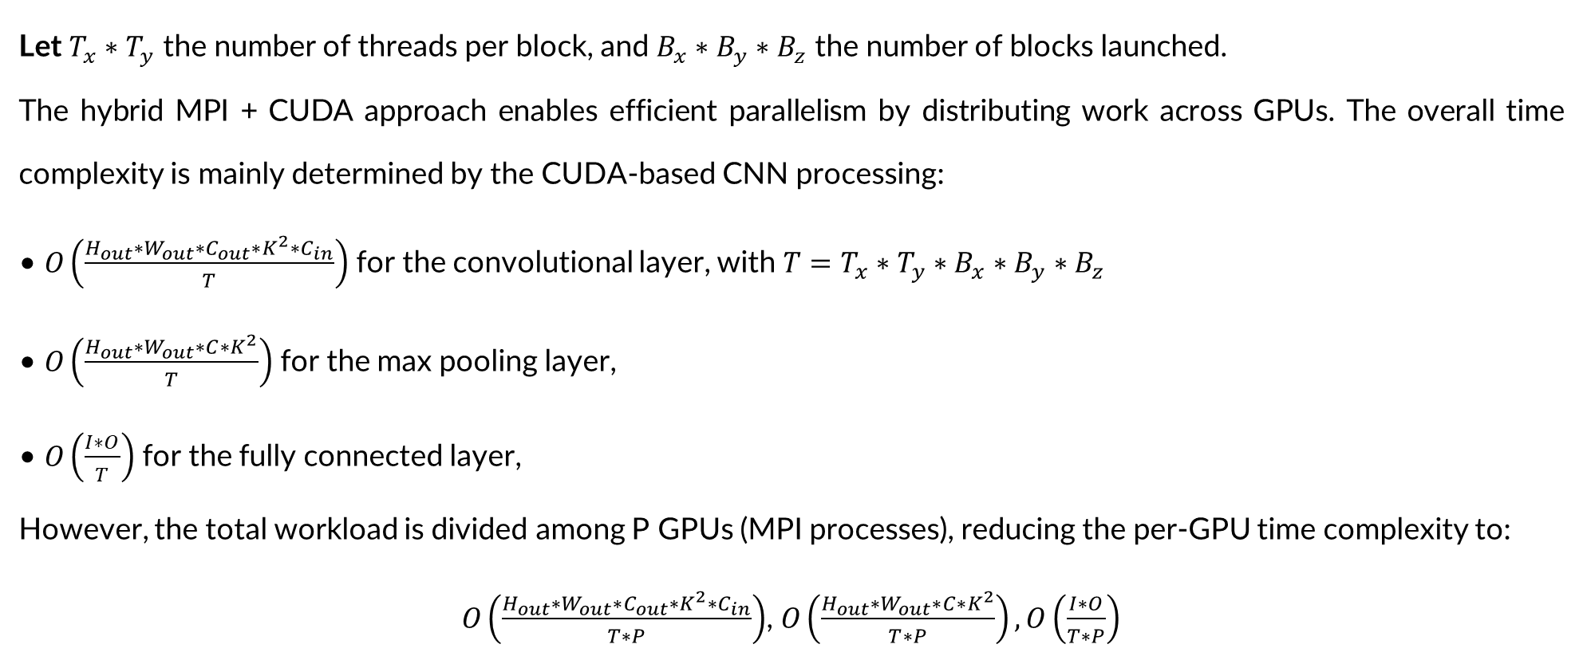
3. Hybrid MPI + CUDA Implementation
3.3. Analysis
Let $T_{x}∗T_{y}$ the number of threads per block, and $B_{x}∗B_{y}∗B_{z}$ the number of blocks launched.
The hybrid MPI + CUDA approach enables efficient parallelism by distributing work across GPUs. The overall time complexity is mainly determined by the CUDA-based CNN processing:
• $O\left(\frac{H_{out}∗W_{out}∗C_{out}∗K^{2}∗C_{in}}{T}\right)$ for the convolutional layer, with $T=T_{x}∗T_{y}∗B_{x}∗B_{y}∗B_{z}$
• $O\left(\frac{H_{out}∗W_{out}∗C∗K^{2}}{T}\right)$ for the max pooling layer,
• $O\left(\frac{I∗O}{T}\right)$ for the fully connected layer,
However, the total workload is divided among P GPUs (MPI processes), reducing the per-GPU time complexity to:
$O\left(\frac{H_{out}∗W_{out}∗C_{out}∗K^{2}∗C_{in}}{T∗P}\right)$, $O\left(\frac{H_{out}∗W_{out}∗C∗K^{2}}{T∗P}\right),O\left(\frac{I∗O}{T∗P}\right)$

Slide 36
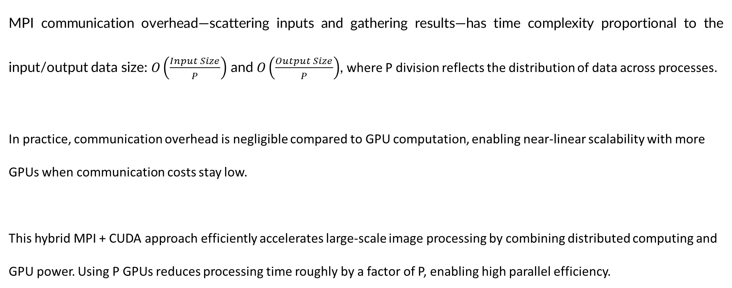
3. Hybrid MPI + CUDA Implementation
3.3. Analysis
MPI communication overhead—scattering inputs and gathering results—has time complexity proportional to the input/output data size: $O\left(\frac{Input Size}{P}\right)$ and $O\left(\frac{Output Size}{P}\right)$, where P division reflects the distribution of data across processes.
In practice, communication overhead is negligible compared to GPU computation, enabling near-linear scalability with more GPUs when communication costs stay low.
This hybrid MPI + CUDA approach efficiently accelerates large-scale image processing by combining distributed computing and GPU power. Using P GPUs reduces processing time roughly by a factor of P, enabling high parallel efficiency.

Slide 37
IV. RESULTS AND CONCLUSION

Slide 38
1. Benchmark Setup
• Batch Size: 16
• Input dimensions: RGB images of 512×512×3
• Network Architecture:
- 12 convolutional layers
- 5×5 kernel size for all convolutions
- 2×2 max pooling after each convolution
- Dimension reduction in FC: flattened → 128 → 64 → 32 →16→8→4→2→1
• Weight initialization: N(0,0.25) for all layers
• Activation function: ReLu

Slide 39
2. Performance Results
Table 1: Performance Comparison of Different Implementation Strategies
Strategy | Wall time (s) | Speedup
Serial (Baseline) | 3.927 | 1.000
MPI (8 processes) | 3.207 | 1.223
CUDA (single GPU) | 0.956 | 4.108
MPI + CUDA (2 GPUs) | 0.446 | 8.805

Slide 40
2. Performance Results
Table 2: Performance Comparison of Implementation Approaches
Implementation | Speedup | Key Characteristics
Pure MPI Implementation (8 processes) | 1.223× | Overhead from process communication and data distribution.
 |  | Limited by CPU-bound nature of computations.
CUDA Implementation (Single GPU) | 4.108× | Effectively utilizes GPU’s parallel architecture.
 |  | Shows the advantage of GPU’s SIMD capabilities for CNN operations.
Hybrid MPI + CUDA (2 GPUs) | 8.805× | Nearly linear scaling with the number of GPUs (2× CUDA performance).
 |  | Effectively combines distributed processing with GPU acceleration.

Slide 41
3. Conclusion
3.1. Key achievements
1. Comprehensive Implementation
• Sequential implementation as baseline
• MPI-based, CUDA-based and hybrid MPI+CUDA implementation.
2. Scalable Architecture.
• Modular design for easy implementation switching
• Flexible CNN processes batches with varied configurations
3. Performance Optimization.
• Hybrid MPI+CUDA implementation achieves ~9× speedup
• Multi‐GPU load balancing with minimal overhead

Slide 42
3. Conclusion
3.2. Limitations
• MPI scales poorly due to communication overhead
• CPU–GPU memory transfers remain performance bottleneck
• Requires identical GPU configurations for implementation
3.3. Future Work
• Enhanced Load Balancing: Adaptive load balancing based on device capabilities
• Memory Optimization: Explore zero-copy and unified memory architectures
• Network Architecture: Add support for complex CNN network architectures
• Multi-Node Support: Extend multi-node support for heterogeneous GPU clusters

Slide 43
THANK YOU !

